Slide 1
Crosswalk and the Intel® XDK – bringing high performance hybrid HTML5 applications to the masses.
Ian Maffett – Developer Advocate, Intel
Bob Spencer - Sr. Software Engineer, Intel

Slide 2
Software Services Group
“The biggest software company you’ve never heard of” - Forbes
Top Linux kernel contributor
64 bit Android support
Compilers/Performance analyzers
INDE
Runtimes (Crosswalk)
HTML5 Tools

Slide 3
Agenda
Hybrid apps, the Intel® XDK, and Crosswalk
Why HTML5?
What is the Intel® XDK
The Runtime
Cloud Builds/Debugging
WebGL Apps
Business/Enterprise Apps
Crosswalk

Slide 4
The Intel® XDK is free
Free to use, free to build. Doesn’t matter about the size of your company.

Slide 5
What is the Intel® XDK?

Slide 6
An IDE, Cordova*, and the cloud
But what’s an IDE?
Integro-Differential Equation?
Integrated Device Electronics
Integrated Development Environment
Mostly, but use what parts you want.
Use any editor you want

Slide 7

XDK?
Crossfit Determined Kipup
Crosswalk Deployment Kit
Today it is
Crossplatform Development Kit
Deploy to different stores with the same codebase

Slide 8


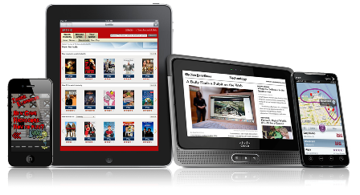
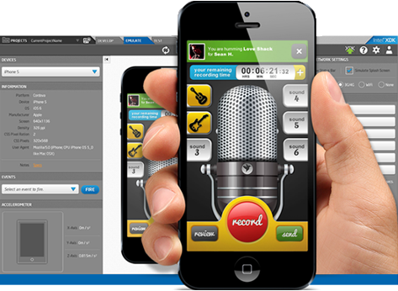



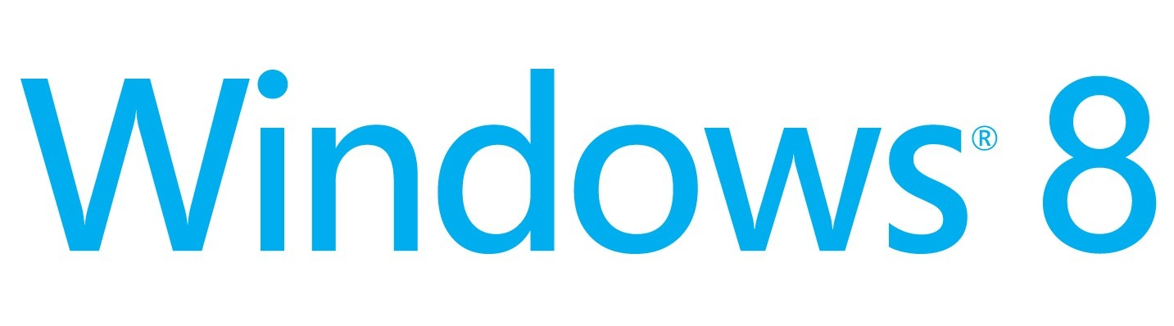


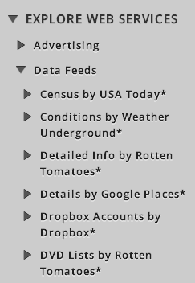





Intel® XDK: Hybrid HTML5 Mobile App Development
Services and Content thru APIs and Plugins
Multiple Form Factors and Platforms
Debug and Test Tools
HTML5 Brackets* Editor
App Designer Layout Editor
Ripple* Cordova* Emulator
Intel App Preview Debugger
Remote Chrome* DevTools*
“weinre” Remote Inspector
On Device Live Preview
iOS* - iPhone* and iPad*
Android* - x86 and ARM*
Crosswalk* - x86 and ARM
Windows* 8 Store - “Metro” UI
Windows 8 Phone
HTML5 Packaged Web Apps:
Tizen*, Firefox* and Chrome
Mashery* (et al)

Slide 9
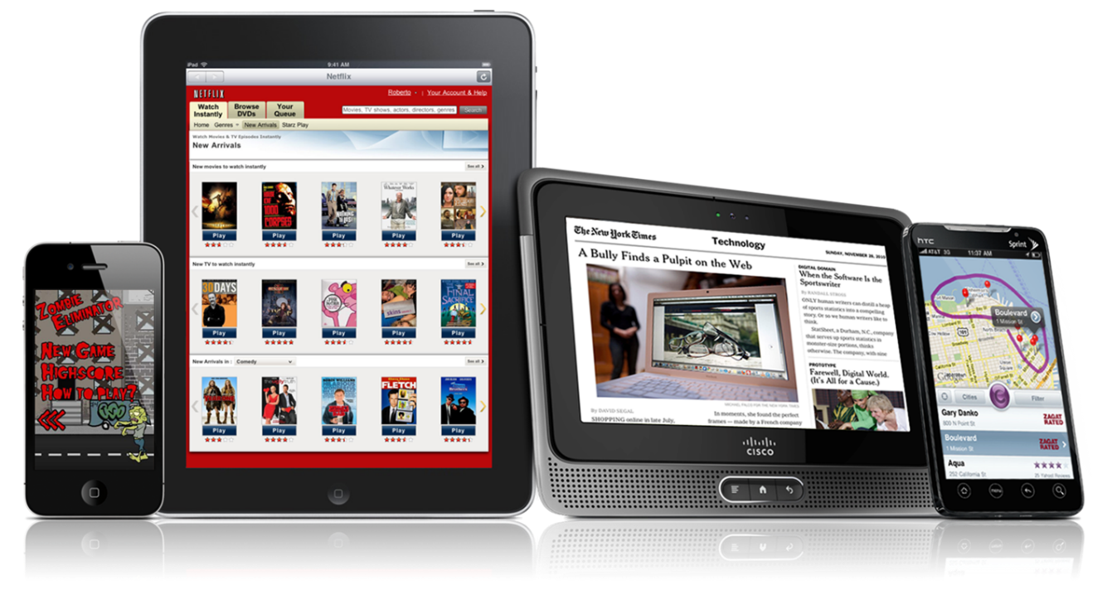
Why HTML5?
HTML5 is the language of the web!
Flexible, Adaptable
Used by millions of developers
HTML5 == HTML5/CSS3/JS

Slide 10



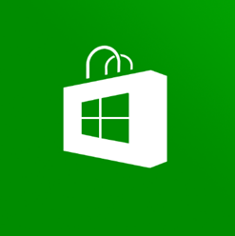
Hybrid HTML5 Apps…
…allow developers to build apps using these skills and tools…
…that can be distributed in native app stores.

Slide 11

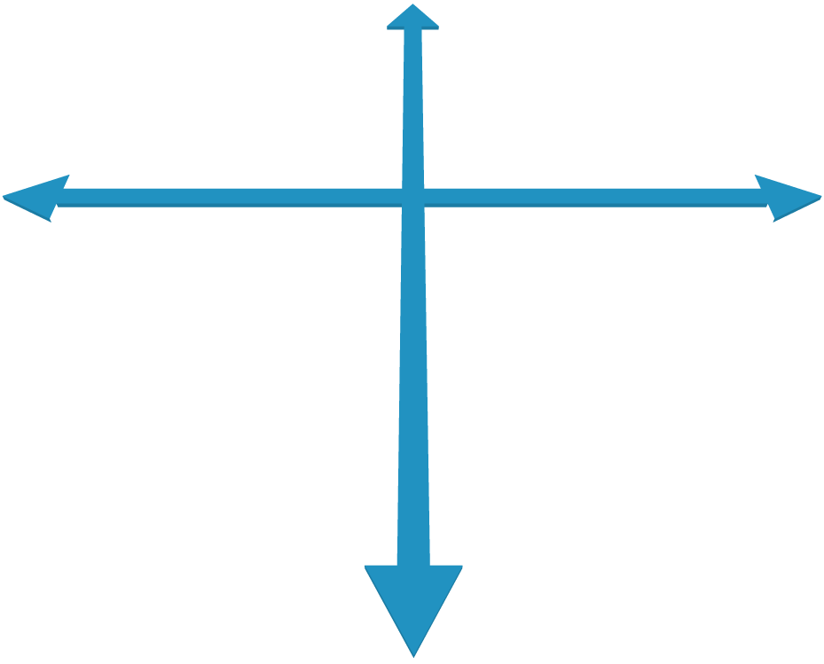








Native vs. Web Apps
Native Apps
Advanced UI Interactions
Smoothest Performance
App Store distribution
Single Platform
Partial Capabilities
Full Capabilities
Web Apps
Web Developer Skills
Instant updates
Unrestricted Distribution
Multiple Platforms

Slide 12

Native vs. Web Apps
Native Apps
Advanced UI Interactions
Smoothest Performance
App Store distribution
Single Platform
Partial Capabilities
Full Capabilities
Web Apps
Web Developer Skills
Instant updates
Unrestricted Distribution
Hybrid HTML5 Apps
Web developer skills
Access to native platform
App Store distribution
Multiple Platforms

Slide 13
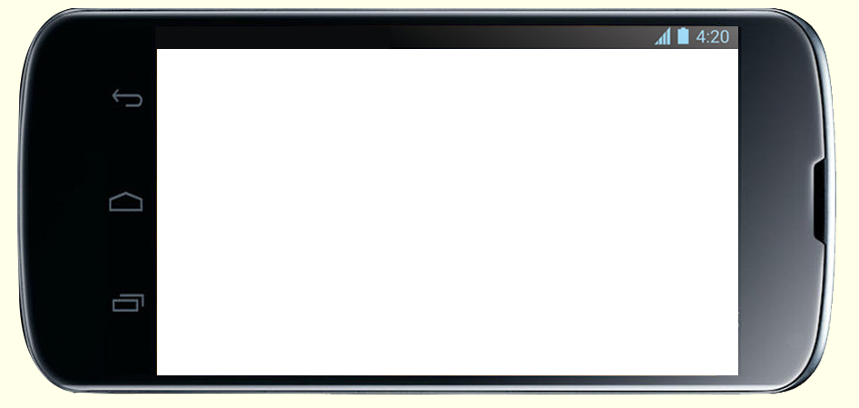
Mobile HTML5 Web App Block Diagram
HTML5 Web App
Mobile Browser
Device Libraries
Restricted Device Access
Mobile Device OS

Slide 14
Mobile Hybrid HTML5 WebView App Block Diagram
Hybrid Extension Bridge
HTML5 WebView App
Device Libraries
Native WebView
Mobile Device OS

Slide 15



Think of Hybrid as a “Black and Tan”
Web App Stuff (stout)
/fōn•gap/ stuff
Native App Stuff (pale ale)
P.S. - It’s spelled “Cordova” but pronounced /fōn•gap/ ☺

Slide 16
Debugging/Profiling
“Whoa” – Keanu Reeves

Slide 17
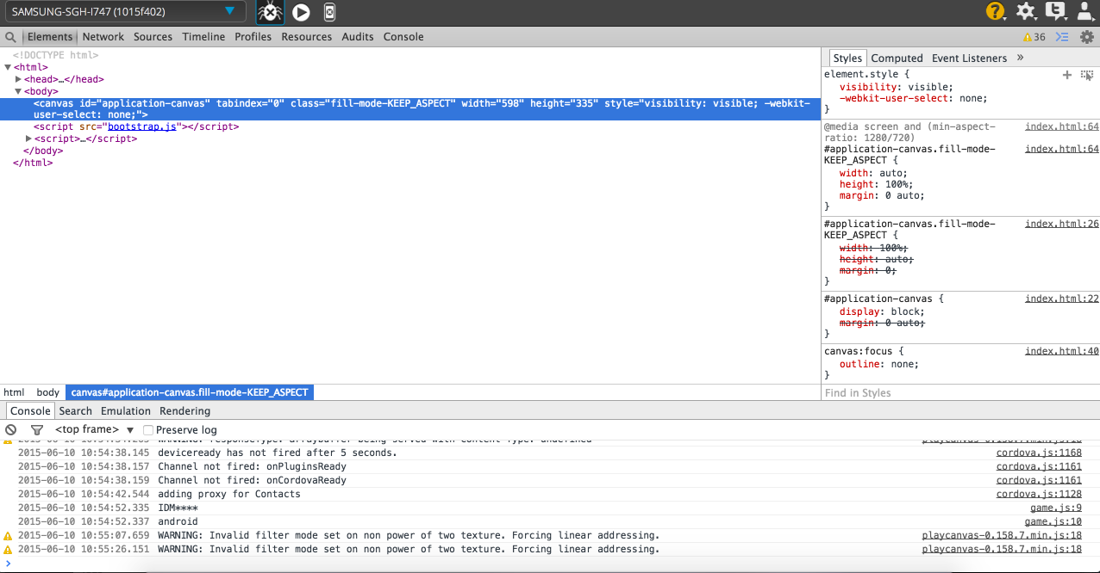
On device debugging

Slide 18
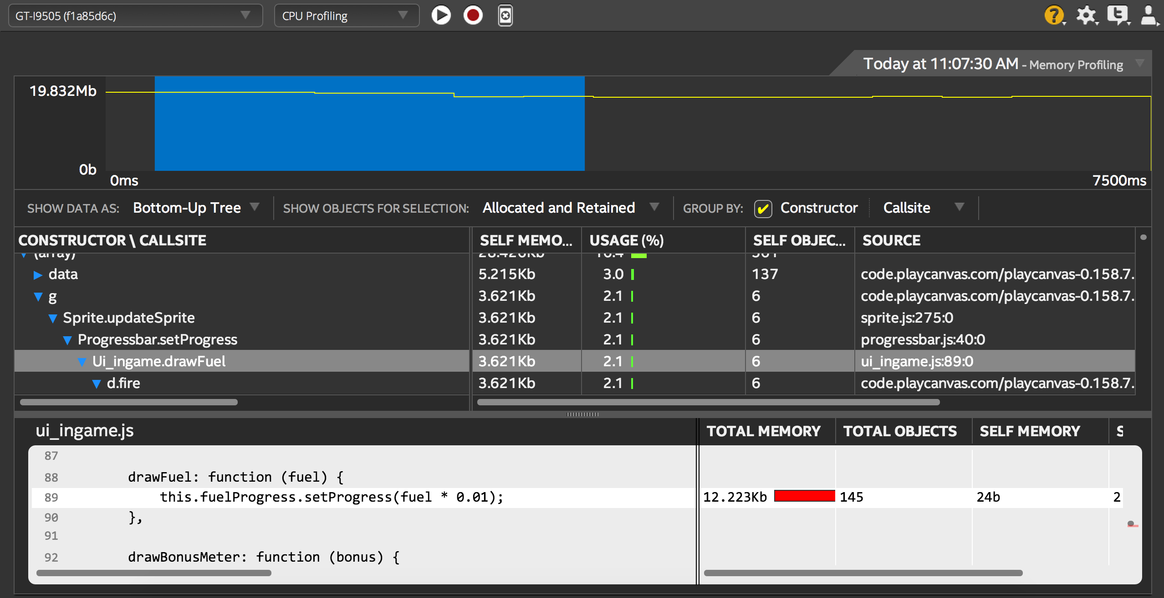
On Device Profiling

Slide 19
Building in the cloud
Nobody understands the cloud!

Slide 20
No SDK’s required.
Build apps in the cloud
Build iOS* apps on a Windows* or Linux* machine.
Cordova based containers.
Additional Intel plugins
Use any Cordova plugin you want.
Featured plugins
Dolby* Audio
Security API’s

Slide 21
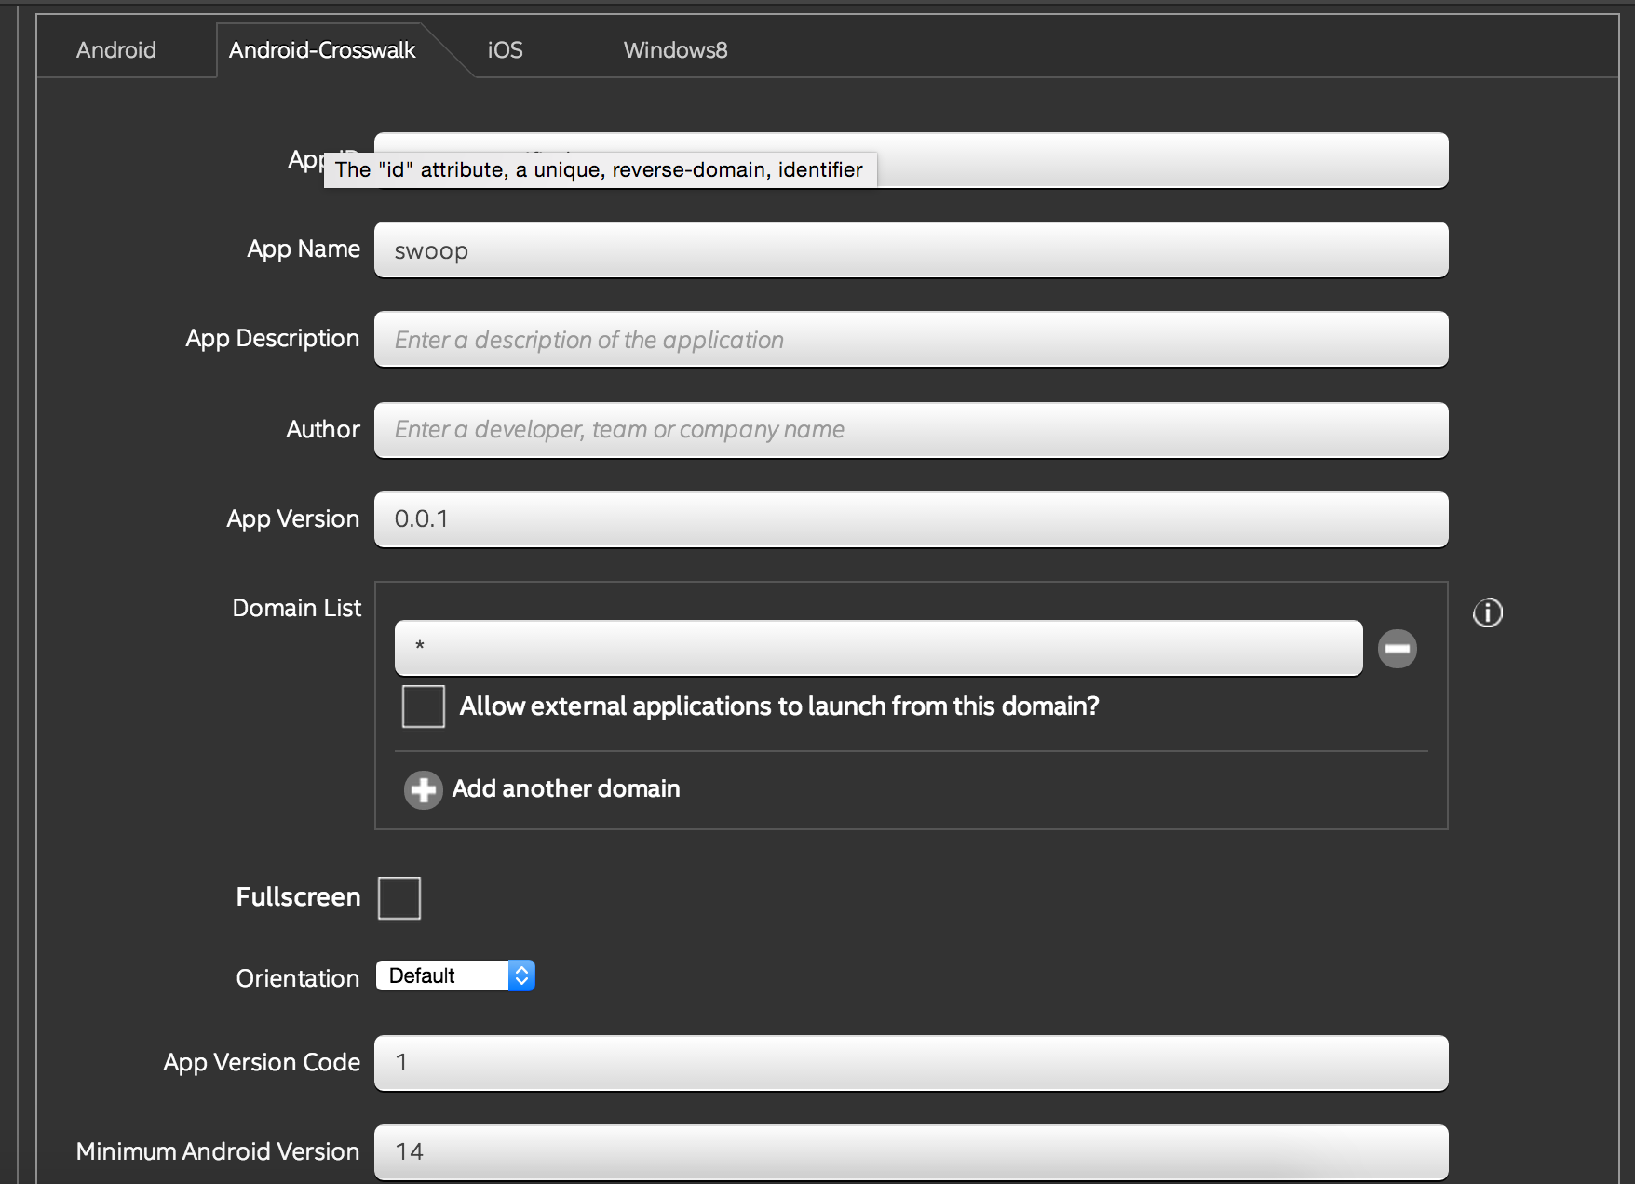
Customize build settings
Defaults for Cordova* apps.
intelxdk.config.additions.xml file to override any other value.
Set the app name /Bundle identifier
Configure Crosswalk version
Set permissions
Manage icons/splash screens
Manage certificates

Slide 22
What really happens with a build
Your bundle is uploaded to S3
Build servers for different deployment targets
Run the Cordova* build command
We fetch the plugins for you
Sign the application with your certificates
If it fails, we give you the build log file
If it’s successful, we give you a secure link to download the binaries.

Slide 23

The cloud is evil!
We are investigating an enterprise version. Possibilities include
Build system/web services exist in your firewall
Work with industry leading Mobile Application Management systems.
Custom features developed for the XDK
Come visit us at the Intel booth to learn more.
Tell us if you are interested
Tell us what features you’d like to see in your environment.

Slide 24
Secure Data API’s
Currently only available with the Intel® XDK Cloud builds

Slide 25
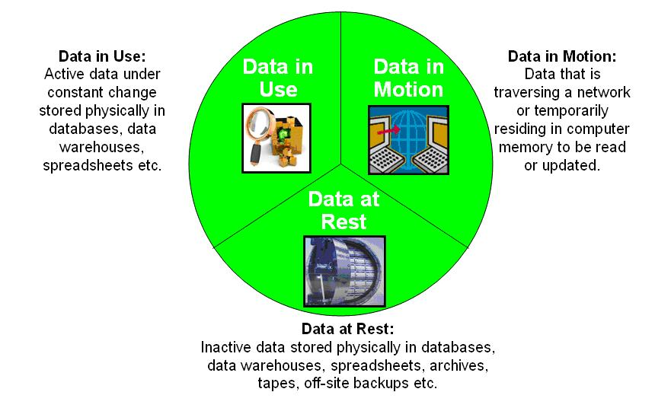
Secure data at all times
Not available
Notes:
Collection of API that provide data in-use protection and data sealing support. Enables creating, managing and using a data stream object in memory. Access to this object is done via an instance ID. Sensitive object properties and sensitive content are hidden.
A typical usage is to create an instance of secure data from plaintext data. At this point, access to the secure data is controlled and protected by the App Security API and the original data can be erased. You can revert back to the unprotected data, or get a sealed chunk. The confidentiality and integrity of the sealed chunk is protected by encryption and signing. You do not need to deal with encryption, signing, or key management; the App Security API does this for you.
Collection of API that provide data at-rest protection. Enables storing and retrieving data objects using non-volatile storage.
A typical usage is to add protection over the stored data using a non-volatile storage. Access to the stored data is controlled and protected by the App Security API. The confidentiality and integrity of the stored data is protected by encryption and signing. You do not need to deal with encryption, signing, or key management; the App Security API does this for you. Any unauthorized change of the stored data is detected at this stage. When a stored data is no longer needed, you can use the delete API to remove it from the non-volatile storage.

Slide 26
Remember, the Intel® XDK is free
Free to use, free to build. Doesn’t matter about the size of your company.

Slide 27
Trying it out
Get the Intel XDK

Slide 28
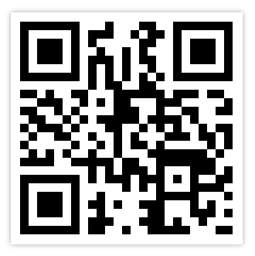

Download the Intel® XDK
xdk.intel.com
Experiment with the demo apps.
Visit the Intel booth for an in-depth demo.

Slide 29



Download App Preview onto your Device
Android*
bit.ly/1i8VEgl
Windows* 8 bit.ly/1j8rxdJ
iOS*
bit.ly/1a3W7Bk

Slide 30
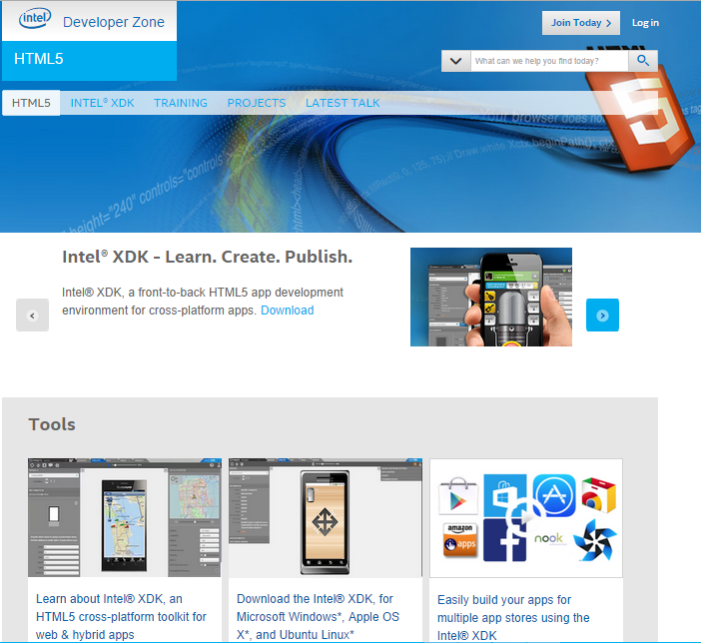
Intel® Developer Zone
Tools. Knowledge. Community.
Free tools and code samples
Technical articles, forums and tutorials
Connect with Intel and industry experts
Get development support
Build relationships
software.intel.com

Slide 31


Slide 32
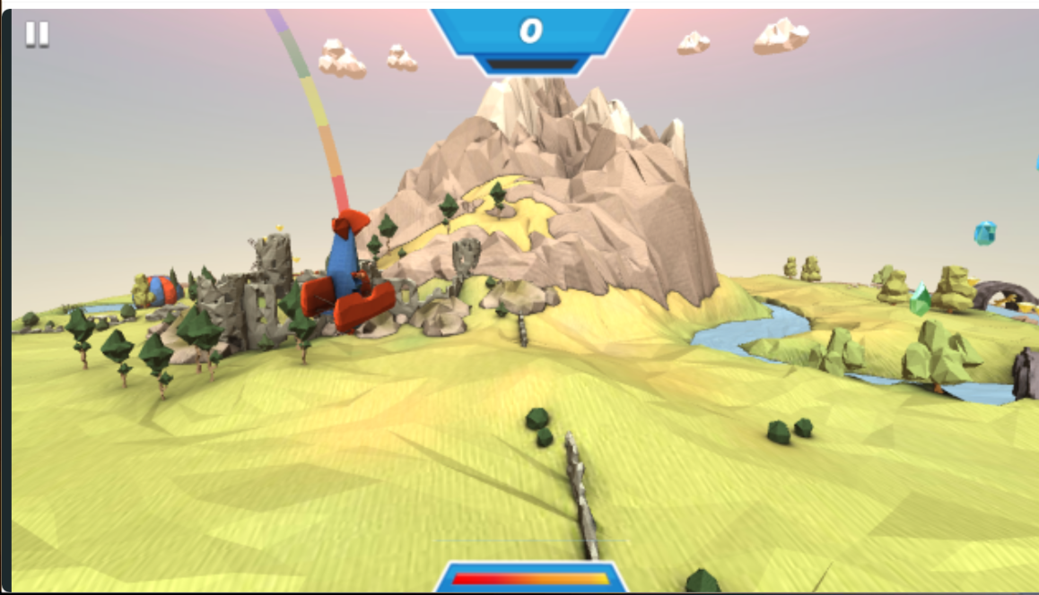
WebGL Games
Crosswalk brought WebGL to Android first.
Build amazing 3d games
xwalk —ignore-gpu-blacklist – let’s you bypass gpu blacklisting from Google
Swoop – PlayCanvas game
Come play it at the Intel booth

Slide 33

Business Applications
Fluid scrolling and animations.
Hybrid Android apps finally perform great!
Recommended by Google*, Sencha*, and Ionic* for building your apps.
Build with any UI framework you want and harness the performance gains.
Deploy to other stores with the same code base.

Slide 34
Crosswalk Project

Slide 35
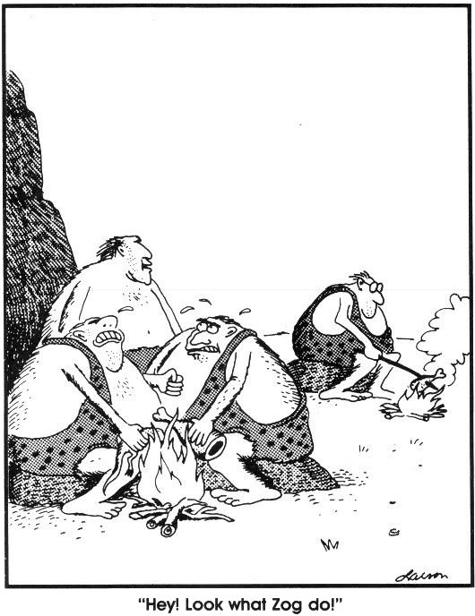
Intel
Web apps 15 years ago
Notes:
KitKat 4.4+
JellyBean 4.1+
ICE 4.0

Slide 36
Web Innovation
Rapidly evolving.
Highly progressive.
Exciting.
Competitive.
File System API
GeoLocation
Web SQL
Content Security
Service Worker
Web Components
Gradients
SIMD
WebRTC
WebCL
Custom API
extensions
Media Queries
Push API
Contacts API
Canvas
Touch Events
Vibration API
Web socket
AJAX
WebGL 2
Flexbox
Web Animations
GamePad API
Web Notifications
Responsive design
Web Bluetooth
Web Speech
Beacon
WebGL
Web Audio
P2P
Sandboxing
CSS Transforms
Geofencing
SVG 2
Message channels
Web MIDI
Streams
MediaRecorder
Web Storage
Cloud services
WebVR
REST
HTML5 Audio/Video
Web socket
Remote desktop
Native client
Navigation
Page Visibility
Web Messaging

Slide 37
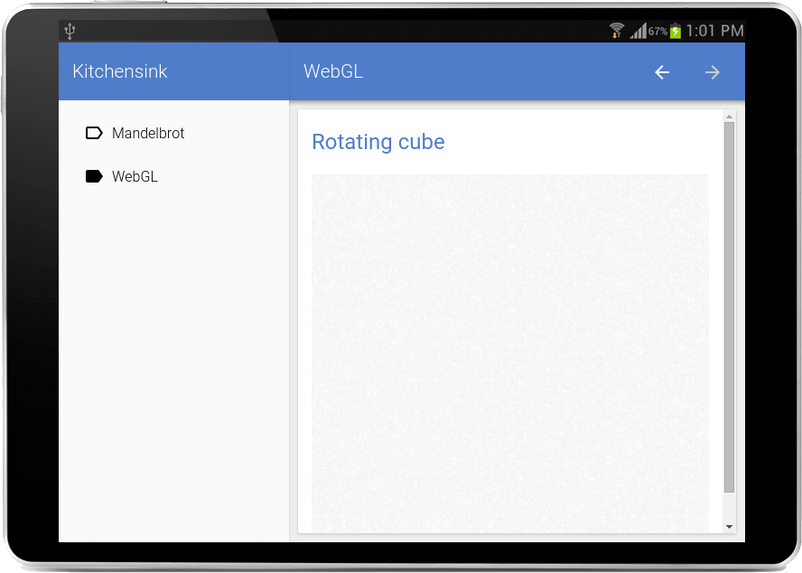

Web Innovation Example
Web Components and
WebGL
Using Android 5.0+
(Lollipop)
Notes:
KitKat 4.4+
JellyBean 4.1+
ICE 4.0

Slide 38
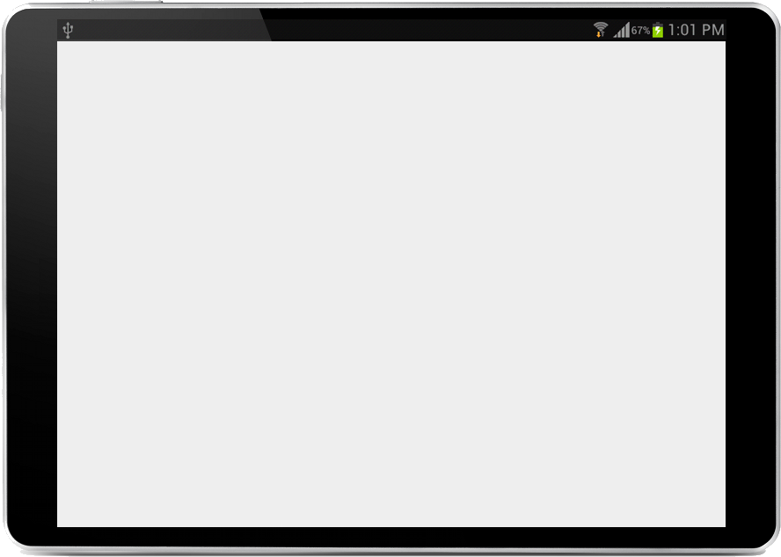
Web Innovation Example
Web Components and
WebGL
On Android 4.4+
(KitKat)
Notes:
KitKat 4.4+
JellyBean 4.1+
ICE 4.0

Slide 39
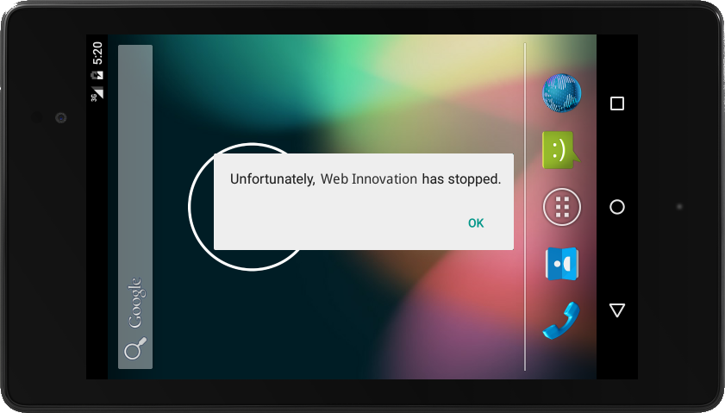
Web Innovation Example
Web Components and
WebGL
On Android 4.0+
(ICS)
Notes:
KitKat 4.4+
JellyBean 4.1+
ICE 4.0

Slide 40
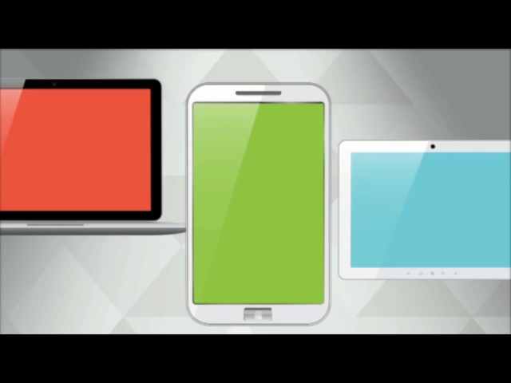
What if...
New web technologies were available...
Your latest application behaved the same...
Your target market increased...
...on all Android devices
Notes:
KitKat 4.4+
JellyBean 4.1+
ICE 4.0

Slide 41


Advanced HTML5 runtime based on Google’s Blink and Chromium
Designed for ambitious web apps
Exceptional performance for Android apps using web technologies
Reduces Android fragmentation
crosswalk-project.org @xwalk_project
Notes:
HTML5 Crosswalk:
Free tools.
Crosswalk can provide near native performance for Android apps that use web technologies
Crosswalk virtually eliminates Android fragmentation from version 4.0 and beyond
Developers can use the Intel(r) XDK, Cordova, Eclipse or command line tools to create Crosswalk applications
Fully open source project with a roadmap, updates every 6wks, and released under a permissive BSD

Slide 42

Crosswalk Project Goals
Enable latest, advanced web application features across all Android devices (v4.0+)
Based on W3C standards and landing zone for new draft APIs and Intel differentiation, such as SIMD and Presentation API
Bring web applications to the next level, closer to native
Inclusion with favorite developer tools and APIs
PhoneGap / Cordova, Intel® XDK, etc.
Good co-operation with upstream projects
Chromium, Blink, Skia, V8, Wayland
crosswalk-project.org @xwalk_project
Notes:
Based on Blink and selected parts of Chromium. Blink: most competitive HTML5 engine
Work with upstream to enable features we need
Minimize the changes on Crosswalk Blink and Chromium
Crosswalk rapid release cycle always updated with the latest Chromium version.
API extensions in separate repositories
Cordova APIs, early or experimental W3C APIs

Slide 43
Wonderfully Open Source
Fully open source project – embraces participation
BSD licensed. Started in September, 2013.
6-week release cadence. Stable, Beta and Canary channels.
GitHub for code and reviews. JIRA for features and bugs. FreeNode for IRC.
Plans, support, and feature ownership via mailing list
crosswalk-project.org @xwalk_project

Slide 44
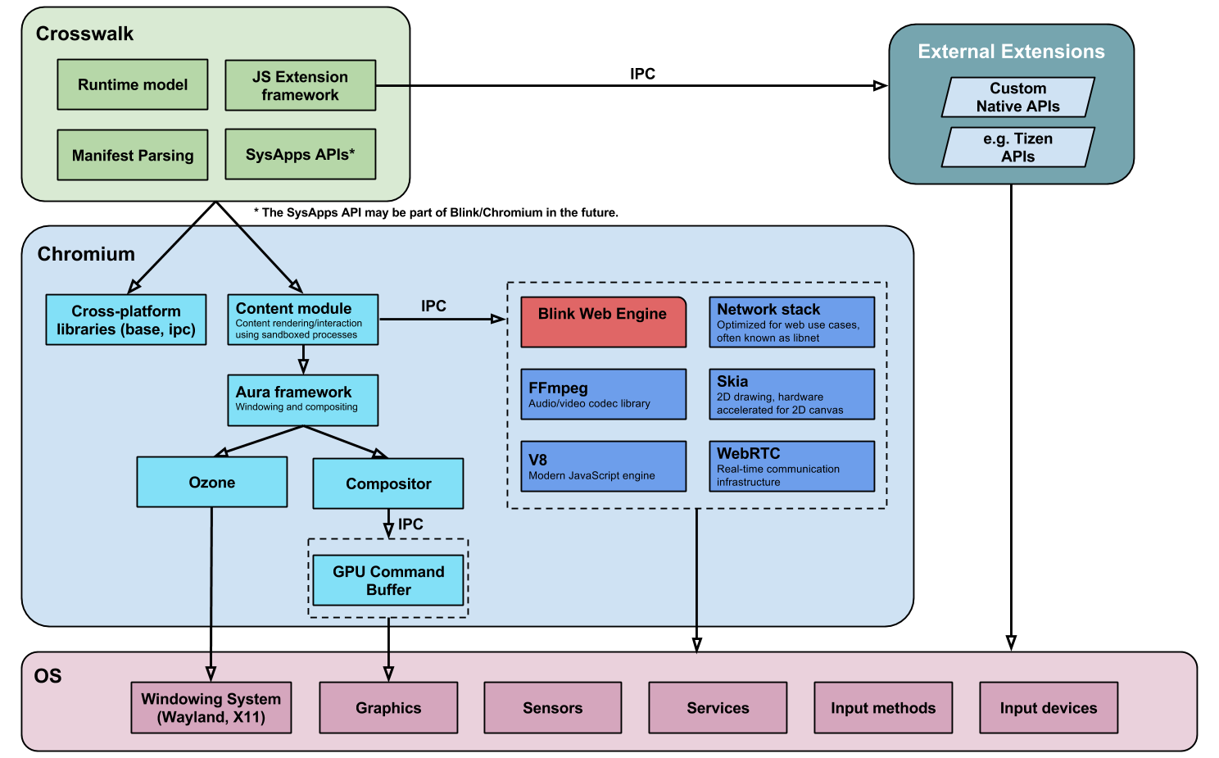

crosswalk-project.org @xwalk_project

Slide 45
Features and APIs
Web Components: Future of the web app design
Service Worker: Closing the gap between the native and web applications
Responsive Design: Media queries (L4), @viewport, Picture element, srcset attribute
Native Client: Portable version, pNaCl
Manifest: Standard manifest for web applications
W3C SysApps: Raw Sockets
W3C SysApps: Device Capabilities
W3C SysApps: App URI
crosswalk-project.org @xwalk_project

Slide 46
Features and APIs (cont.)
W3C Promises API
W3C Resource Timing API
W3C User Timing API
W3C Ambient Light API
W3C GamePad API
EcmaScript SIMD
W3C WebRTC
W3C WebGL, Canvas
W3C Web Animations
HTML5 input enhancements: context menu, pattern attribute, data list element, autocomplete
Beacon
Vehicle and DLNA API (IVI)
crosswalk-project.org @xwalk_project

Slide 47
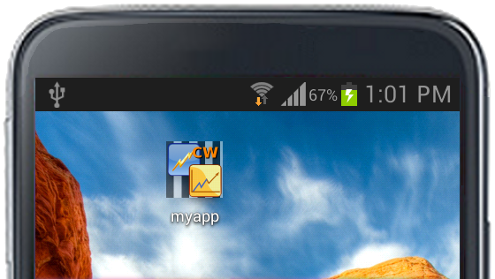
Building with Crosswalk
 | Stable | Beta | Canary
Android (ARM + x86) | 11.40.277.7 | 12.41.296.4 | 13.41.313.0
Android webview (x86) | 11.40.277.7 | 12.41.296.4 | 13.41.313.0
Android webview (ARM) | 11.40.277.7 | 12.41.296.4 | 13.41.313.0
3 easy steps:
Download Crosswalk
Package Crosswalk with your application using make_apk.py:
Bundles Crosswalk runtime with your application
Creates apk for both x86 and arm
3. Install
$ python make_apk.py --package=org.abc.myapp \
--manifest=myapp/manifest.json
$ adb install -r myapp_x86.apk
crosswalk-project.org @xwalk_project

Slide 48
Crosswalk and your Android app
Embedded
Shared
MyApp.apk
MyApp.apk
MyApp.apk
MyApp.apk
App code
HTML, Javascript, CSS, etc.
App code
HTML, Javascript, CSS, etc.
App code
HTML, Javascript, CSS, etc.
App code
HTML, Javascript, CSS, etc.
+
OR
OR
Crosswalk (x86)
Crosswalk (x86)
Crosswalk (arm)
Crosswalk_x86.apk
Crosswalk_arm.apk
Crosswalk (arm)
Crosswalk (x86)
Crosswalk (arm)
Two apks: one for each arch
Crosswalk size:
+20MB in apk
+50MB installed
Submit two apps to the store
One “fat” apk: includes x86 and arm
Crosswalk size:
+40MB in apk
+100MB installed
Submit one app to store
Link to shared Crosswalk library
Dynamically downloaded
Version dynamically updated
crosswalk-project.org @xwalk_project

Slide 49
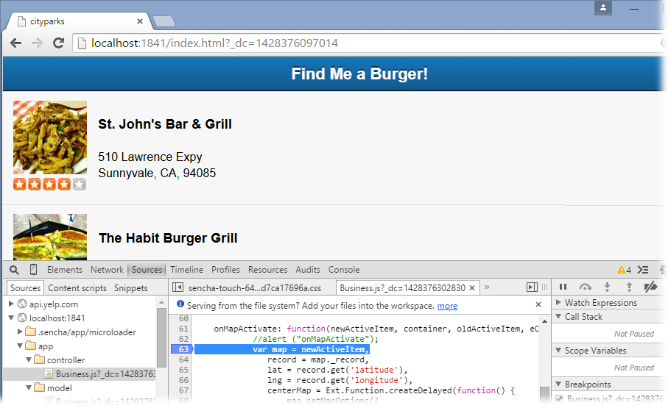
Crosswalk Development
Debug and validate using your preferred process and tools.

Slide 50
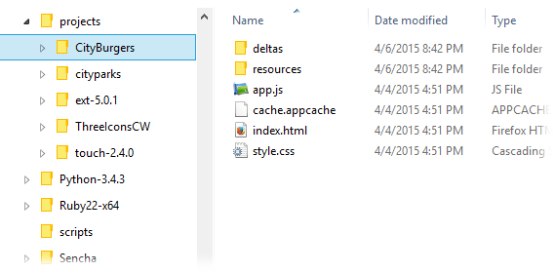
Web project with Crosswalk
Start with web application project directory

Slide 51
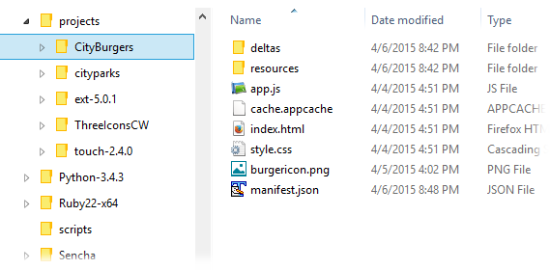

Web project with Crosswalk
Add icon and manifest.json files
manifest
file
crosswalk-project.org @xwalk_project

Slide 52
Crosswalk manifest file
{
"name": "City Burger",
"xwalk_version": "0.0.1",
"xwalk_description": "Bob is hungry for a Burger",
"start_url": "index.html",
"icons": [
{
"src": "burgericon.png",
"sizes": "128x128",
"type": "image/png",
"density": "4.0"
}
],
"xwalk_permissions": [
"Geolocation"
]
}
> make_apk.py --package=org.bob.cityburger \
--manifest=../projects/CityBurger/manifest.json

Slide 53
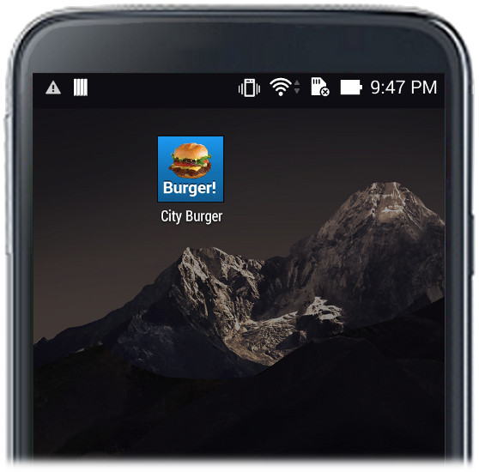
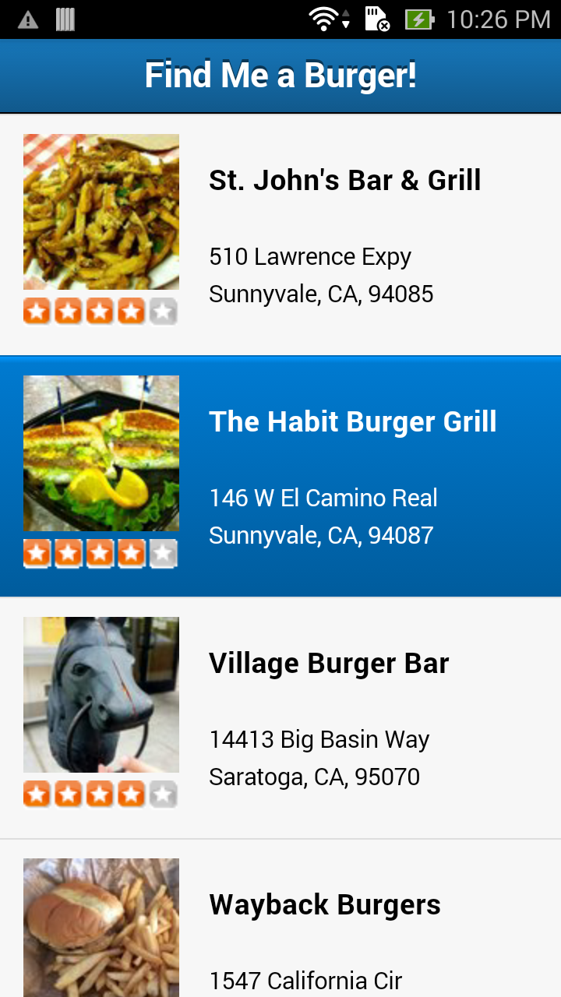
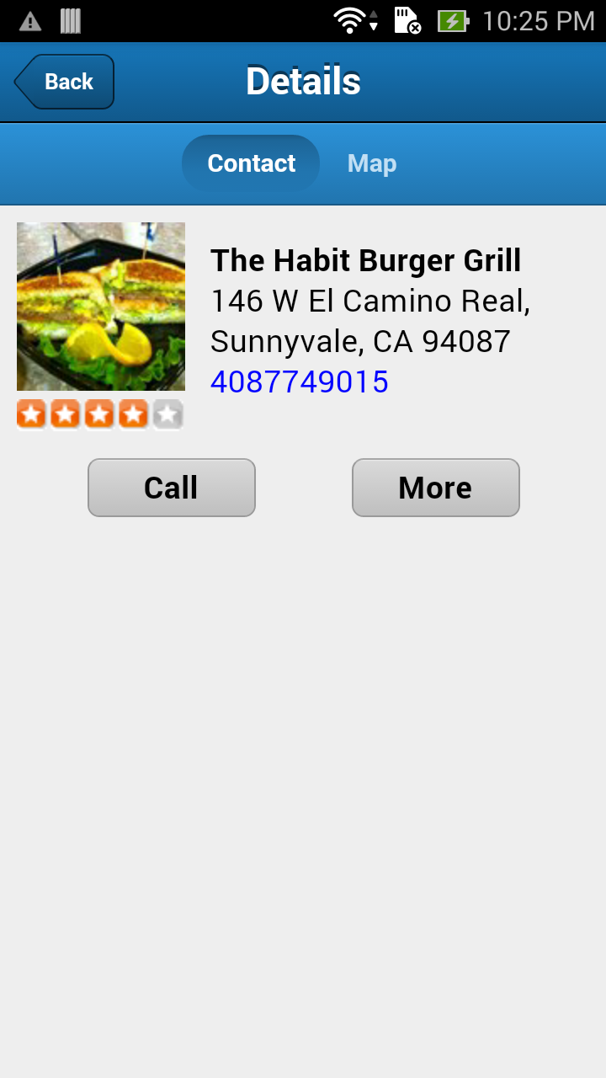
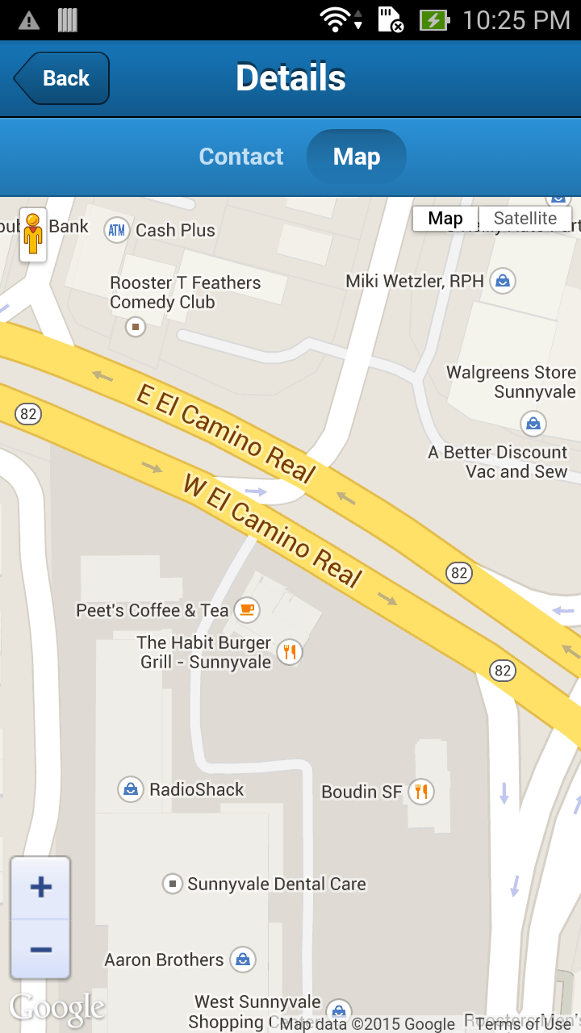
Create Store-ready APK and Deploy
> adb install -r Cityburgers_0.0.1_x86.apk

Slide 54
Target support and Schedule
Current: Android, iOS*, Linux desktop, and Tizen
Windows 10 desktop (Q3 2015)
IoT research in progress

Slide 55
Crosswalk Lite
Research project to reduce size of APK and installed app
Size estimates:
Changes:
Use LZMA compression. Longer first-time startup.
Removed support for:
Web Inspector, remote debugging, FTP protocol, WebRTC, WebP, and XSLT
Crosswalk Project |  | Crosswalk Lite
APK | Installed | APK | Installed
20M | 55M | 10-15M | 40M
http://crosswalk-project.org/blog/crosswalk-lite-10.html

Slide 56
Crosswalk and Cordova
Crosswalk webview plugin to your Cordova project
Drop in replacement of system Web View
www.npmjs.com/package/cordova-plugin-crosswalk-webview

Slide 57
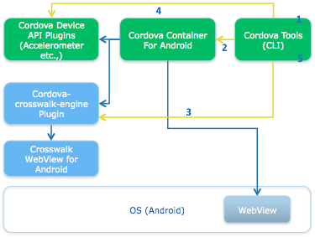
Crosswalk and Cordova
Create app
Install platform
Install webview plugin (new)
Install device API plugins
Build app

Slide 58
Crosswalk and Cordova
$ npm install -g cordova
$ cordova –v
5.0.0
$ cordova create hello com.example.hello HelloWorld
$ cd hello
$ cordova platform add android
$ cordova plugin add cordova-plugin-crosswalk-webview
$ cordova build android

Slide 59
Crosswalk Project Showcase

Slide 60
Consistent Behavior
Default Android Webview
Crosswalk Webview
Crosswalk enables consistent behavior on
more Android versions (Android 4.0+)
Notes:
KitKat 4.4+
JellyBean 4.1+
ICE 4.0

Slide 61


WebCL Acceleration for image and video processing and advanced WebGL physics
Default Android Webview
Crosswalk Webview with WebCL
Notes:
KitKat 4.4+
JellyBean 4.1+
ICE 4.0

Slide 62
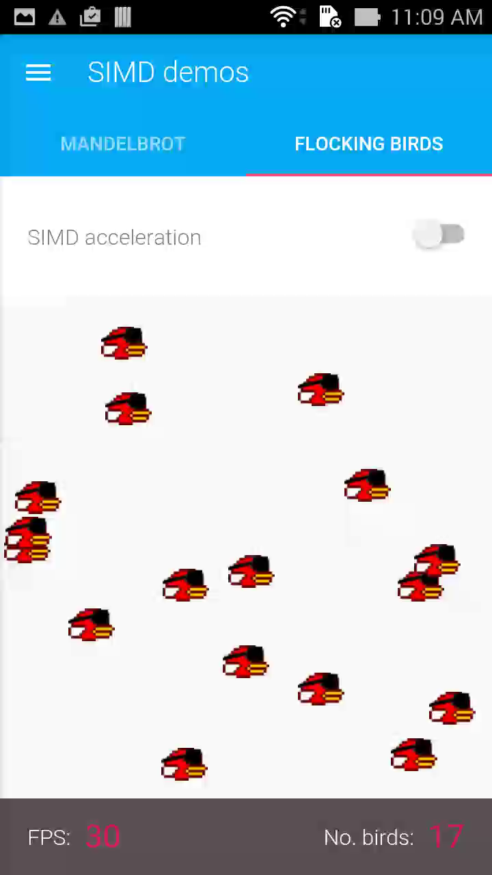
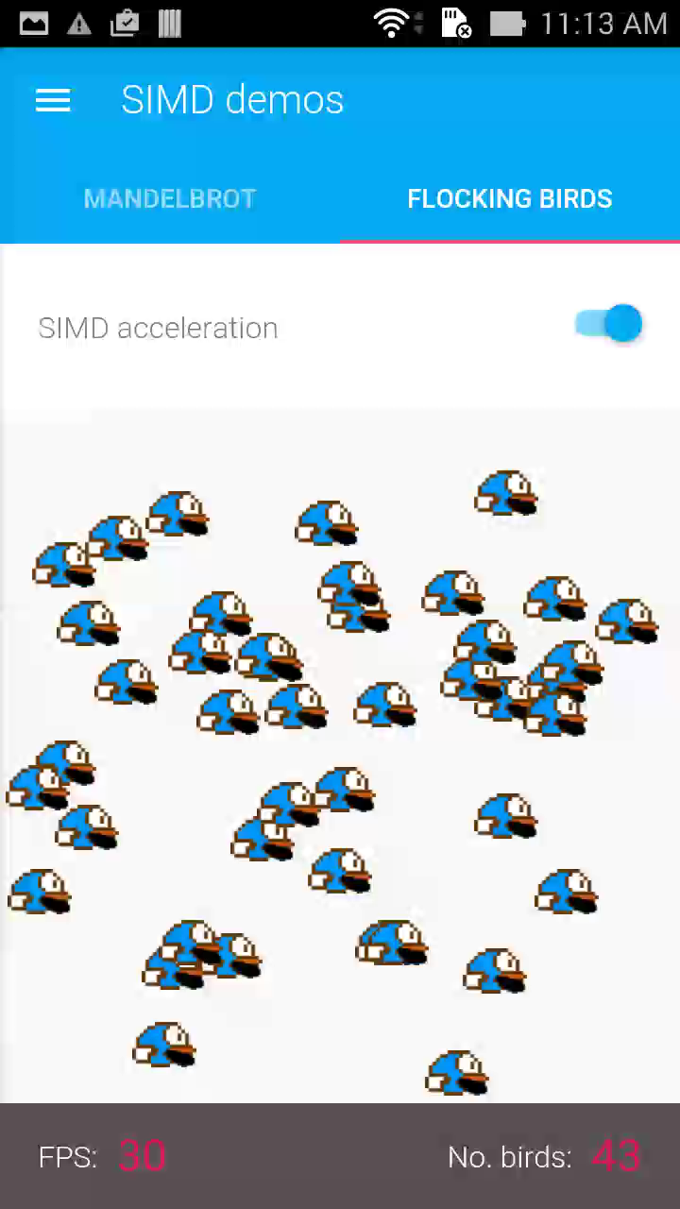
SIMD Perform operations on multiple data elements in parallel
Flocking Birds
Basic physics simulation:
Multiple birds, variable acceleration
Calculating velocity and position
With SIMD, we calculate four birds at the same time.
Default Webview
Webview with SIMD
Notes:
KitKat 4.4+
JellyBean 4.1+
ICE 4.0

Slide 63

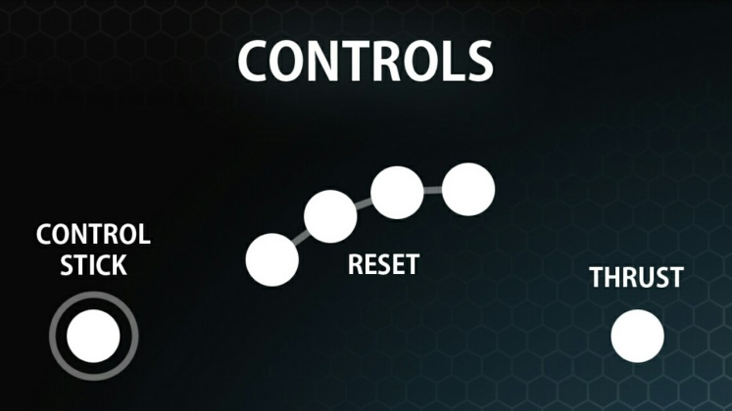
Presentation API Two-screen experience Show different content on the mobile device and monitor
Notes:
KitKat 4.4+
JellyBean 4.1+
ICE 4.0

Slide 64
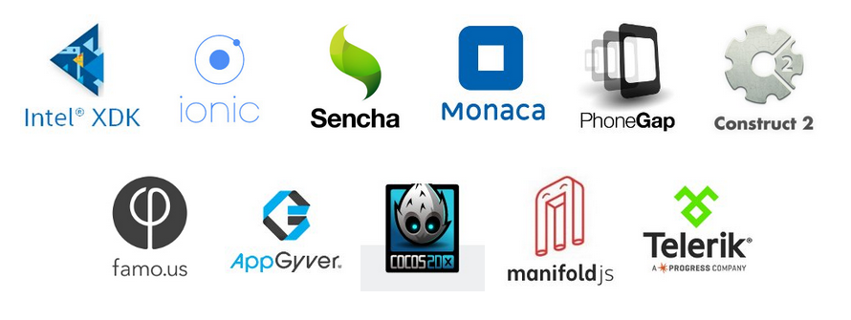
Crosswalk is part of great tools

Slide 65
The Crosswalk Advantage
Advanced web runtime and webview features available for legacy Android platforms
Application consistency across all Android versions
Extendable
Full control over upgrade cycle
Based on Blink and Chromium
Latest innovations, strong performance
Intel is driving innovation in Blink and Chromium, including reviewing and owning various areas of the code base
Wide community adoption and strong corporate backing
Easy to use. A nice combination with Sencha tools and frameworks
Open source

Slide 66
It’s finally possible to build hybrid apps that use a modern web view and run on almost every Android device released within the past three years.
The Crosswalk Project looks like the new, best way to publish HTML5 content to Android.
@xwalk_project I replaced my regular cordova project to Crosswalk and now everything works much better in all devices! *--* #html5 #mobile
@xwalk_project that's some awesome kit you're building there guys. Just factored it into a @meteorjs app and Android perf greatly improved.
Max Woghiren
Software Engineer @ Google
Joe Buckle @ bambattajb
Mozart Diniz @mozartdiniz
Ashley Gullen
Creator of the Construct 2 game engine
10x perf improvement for hybrid apps on Android 4.0-4.3 for 15mb with @xwalk_project. Seems well worth it to me. http://ionicframework.com/blog/crosswalk-comes-to-ionic/ …
@Ionicframework @xwalk_project It's much easier now to debug my #Ionic #apps using @googlechrome Dev Tools in my browser.
I am very confident in my hybrid project now :) @xwalk_project
@xwalk_project Finally something that works!
Chris Wheatley @swirlycheetah
Remzi Cavdar @ remzicavdar
aferrerDev @aferrerDev
David Yarham @davidyarham

Slide 67
Q&A

Slide 68
Legal Notices and Disclaimers
Intel technologies’ features and benefits depend on system configuration and may require enabled hardware, software or service activation. Learn more at intel.com, or from the OEM or retailer.
No computer system can be absolutely secure.
Tests document performance of components on a particular test, in specific systems. Differences in hardware, software, or configuration will affect actual performance. Consult other sources of information to evaluate performance as you consider your purchase. For more complete information about performance and benchmark results, visit http://www.intel.com/performance.
Cost reduction scenarios described are intended as examples of how a given Intel-based product, in the specified circumstances and configurations, may affect future costs and provide cost savings. Circumstances will vary. Intel does not guarantee any costs or cost reduction.
This document contains information on products, services and/or processes in development. All information provided here is subject to change without notice. Contact your Intel representative to obtain the latest forecast, schedule, specifications and roadmaps.
Statements in this document that refer to Intel’s plans and expectations for the quarter, the year, and the future, are forward-looking statements that involve a number of risks and uncertainties. A detailed discussion of the factors that could affect Intel’s results and plans is included in Intel’s SEC filings, including the annual report on Form 10-K.
The products described may contain design defects or errors known as errata which may cause the product to deviate from published specifications. Current characterized errata are available on request.
No license (express or implied, by estoppel or otherwise) to any intellectual property rights is granted by this document.
Intel does not control or audit third-party benchmark data or the web sites referenced in this document. You should visit the referenced web site and confirm whether referenced data are accurate.
Intel, [Add words with TM or R from previous pages..ie Xeon, Core, etc] and the Intel logo are trademarks of Intel Corporation in the United States and other countries.
*Other names and brands may be claimed as the property of others.
© 2015 Intel Corporation.

Slide 70


